Slide 1
Practicing Penitent Praise
Nehemiah 9:1-37
Lewis Winkler
Dr. Rick Griffith, Crossroads International Church Singapore
BibleStudyDownloads.org

Slide 2
Our Present Sermon Series
July-October 2013

Slide 3
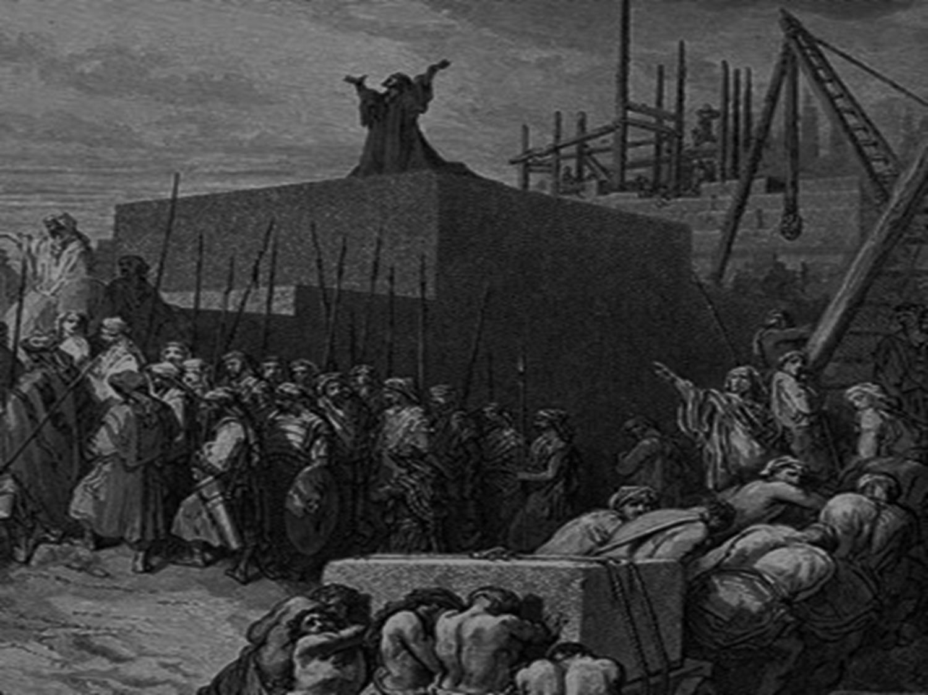
A Brief Review: What God Has Already Done
He has brought back a faithful remnant to live in the land of promise.

Slide 4
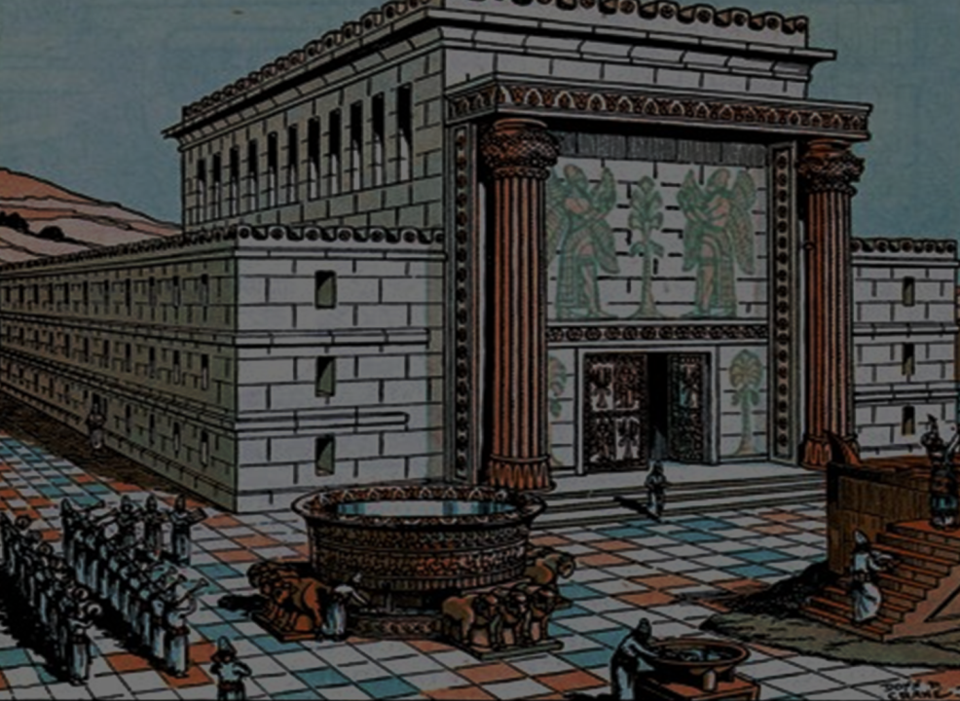
A Brief Review: What God Has Already Done
He has restored the temple through the ministry of Ezra.

Slide 5
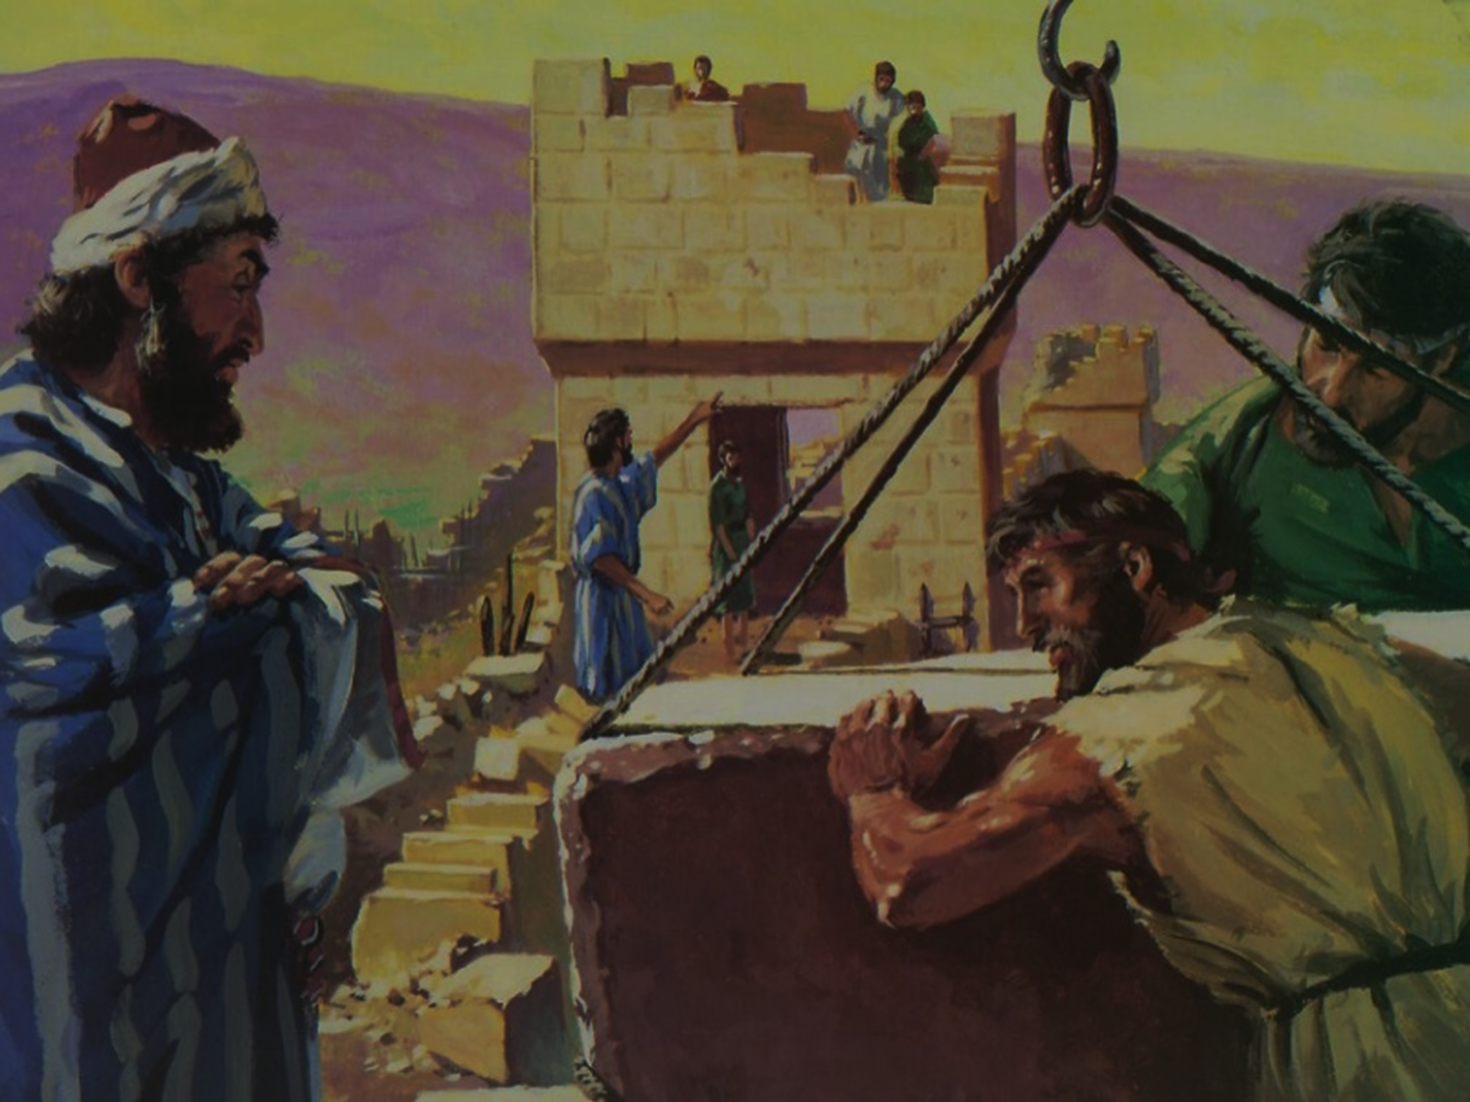
A Brief Review: What God Has Already Done
He has rebuilt the walls of Jerusalem through the leadership of Nehemiah.

Slide 6
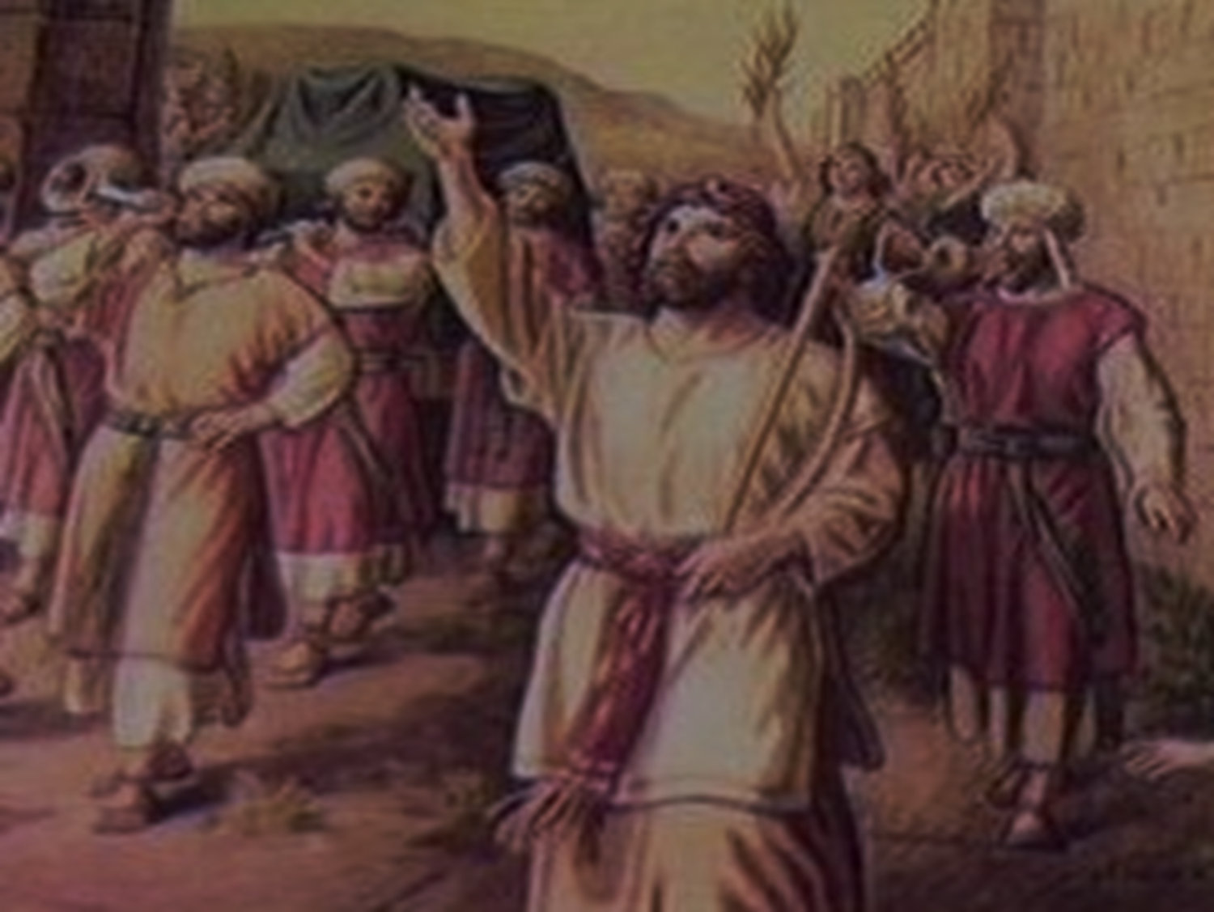
A Brief Review: What God Has Already Done
He has brought about a spiritual revival among the people.

Slide 7
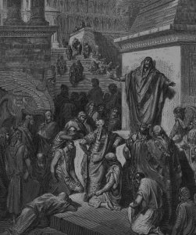
A Time of Confession and Contrition (9:1-5a)

Slide 8
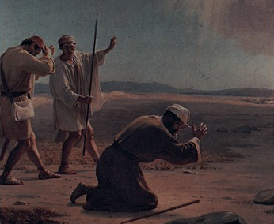
A Prayer of Remorse and Remembrance (5b-31)

Slide 9
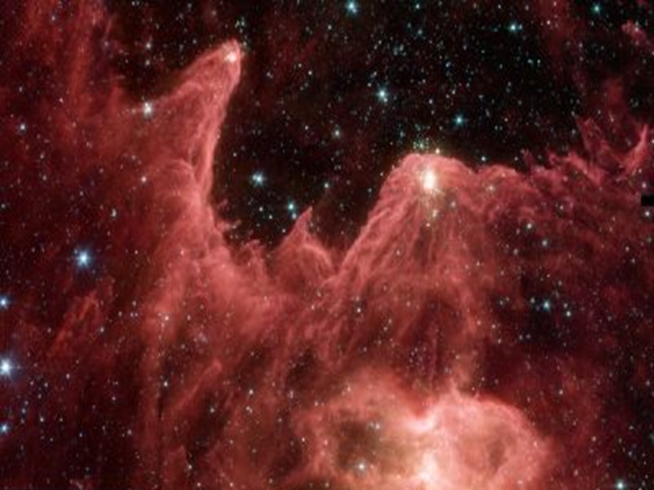
A Prayer of Remorse and Remembrance (5b-31)
God’s sovereignty is shown in creation (vs. 5b-6)

Slide 10
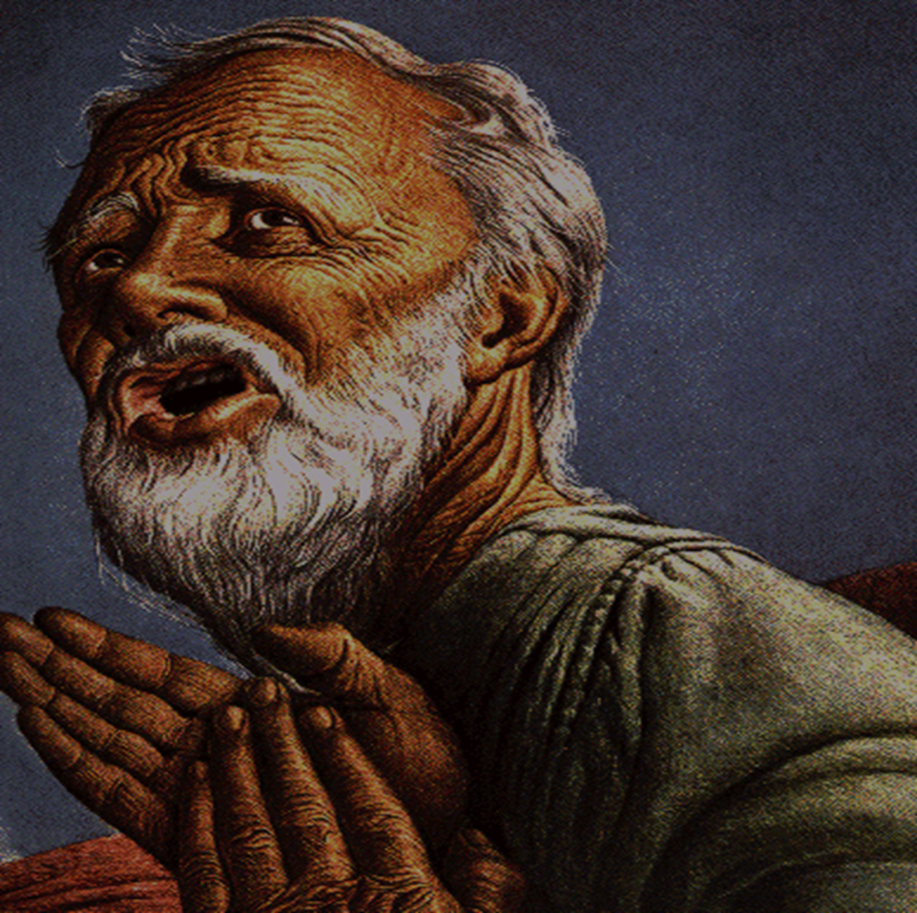
A Prayer of Remorse and Remembrance (5b-31)
God’s grace is shown in choosing Abraham (vs. 7-8)

Slide 11
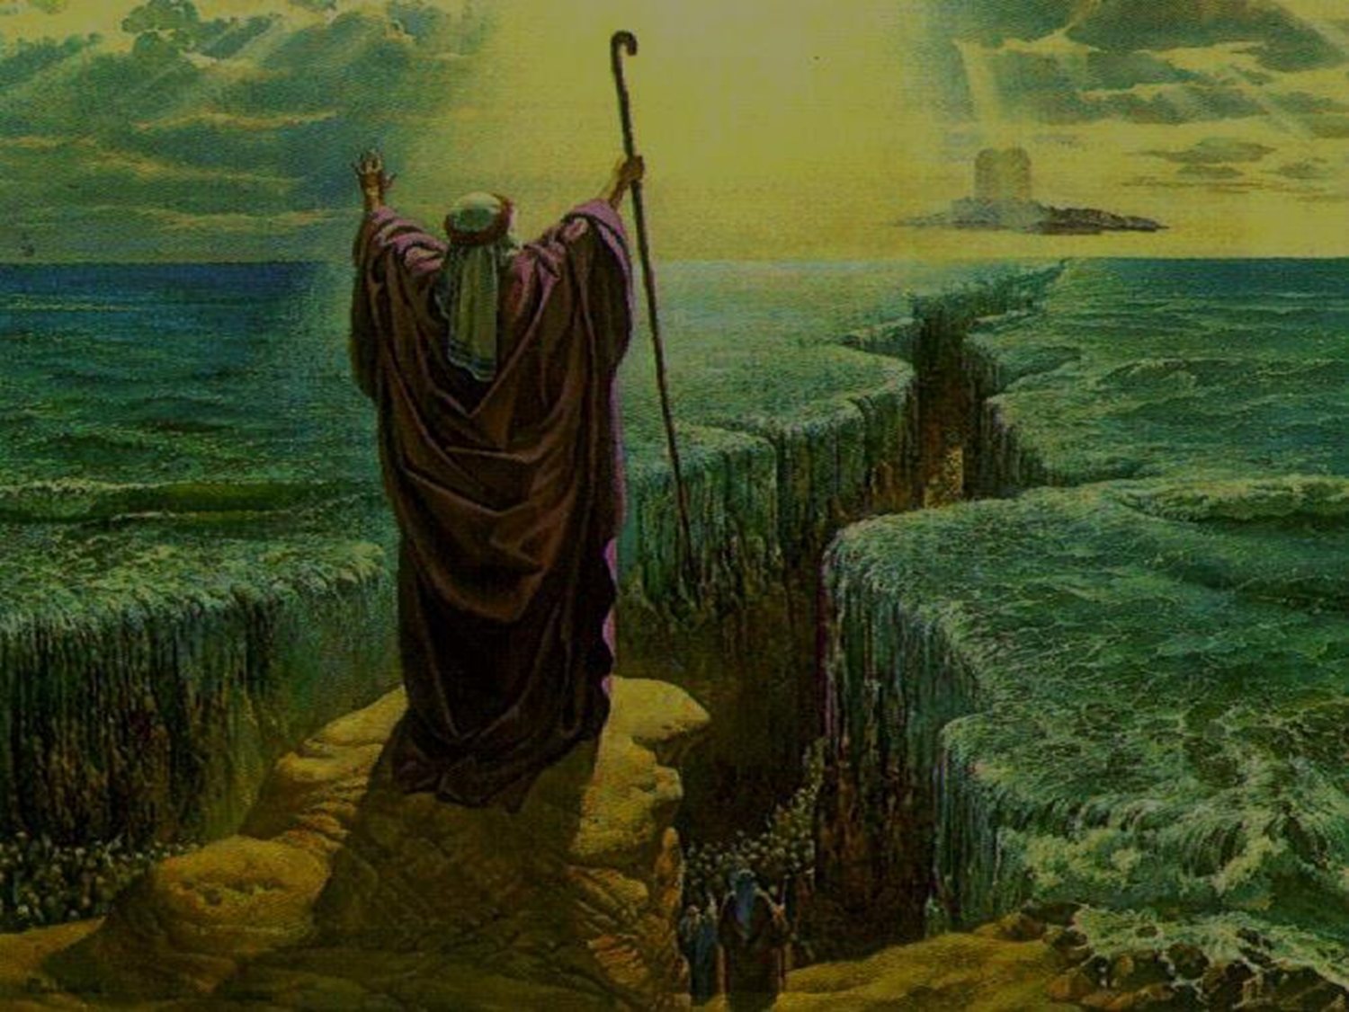
A Prayer of Remorse and Remembrance (5b-31)
God’s grace is shown in the Exodus (vs. 9-21)

Slide 12
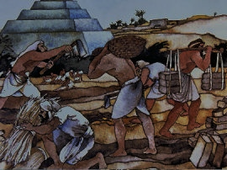
A Prayer of Remorse and Remembrance (5b-31)
God’s grace is shown in the Exodus (vs. 9-21)
9-11: He hears their cry to Him in Egypt and miraculously delivers them.

Slide 13
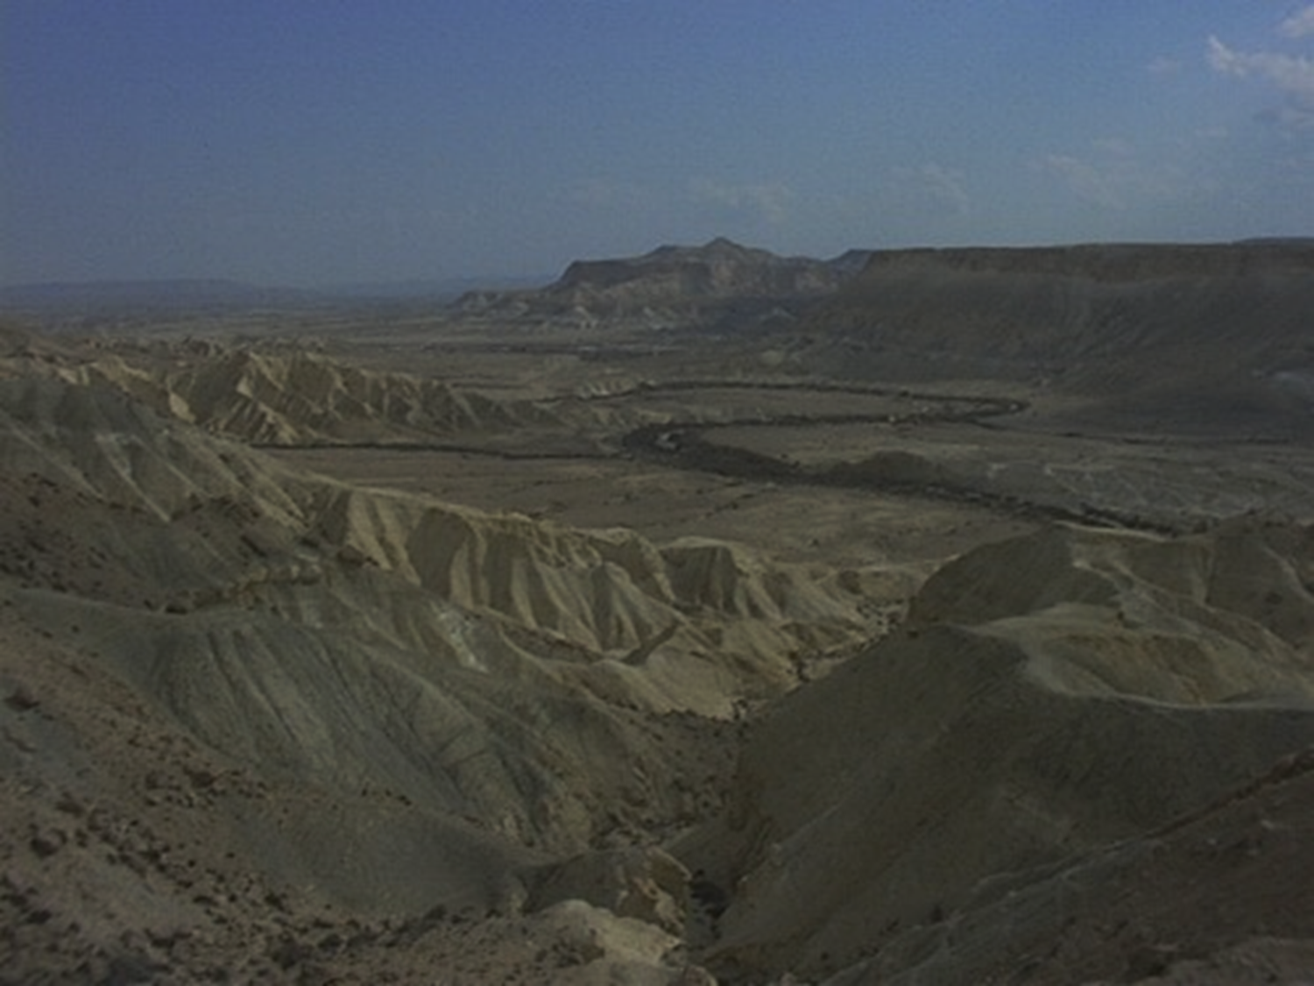
A Prayer of Remorse and Remembrance (5b-31)
God’s grace is shown in the Exodus (vs. 9-21)
12, 15, 19-21: He miraculously sustains them in the wilderness.

Slide 14
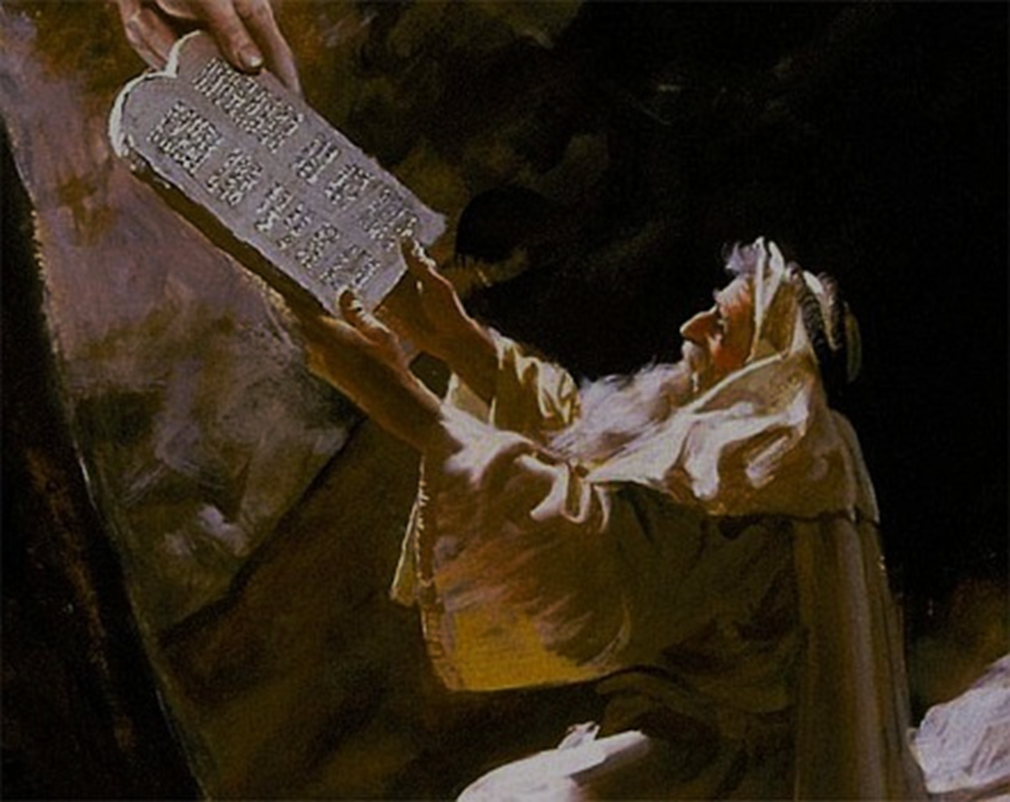
A Prayer of Remorse and Remembrance (5b-31)
God’s grace is shown in the Exodus (vs. 9-21)
13-14: He reveals Himself by giving them the Ten Commandments.

Slide 15
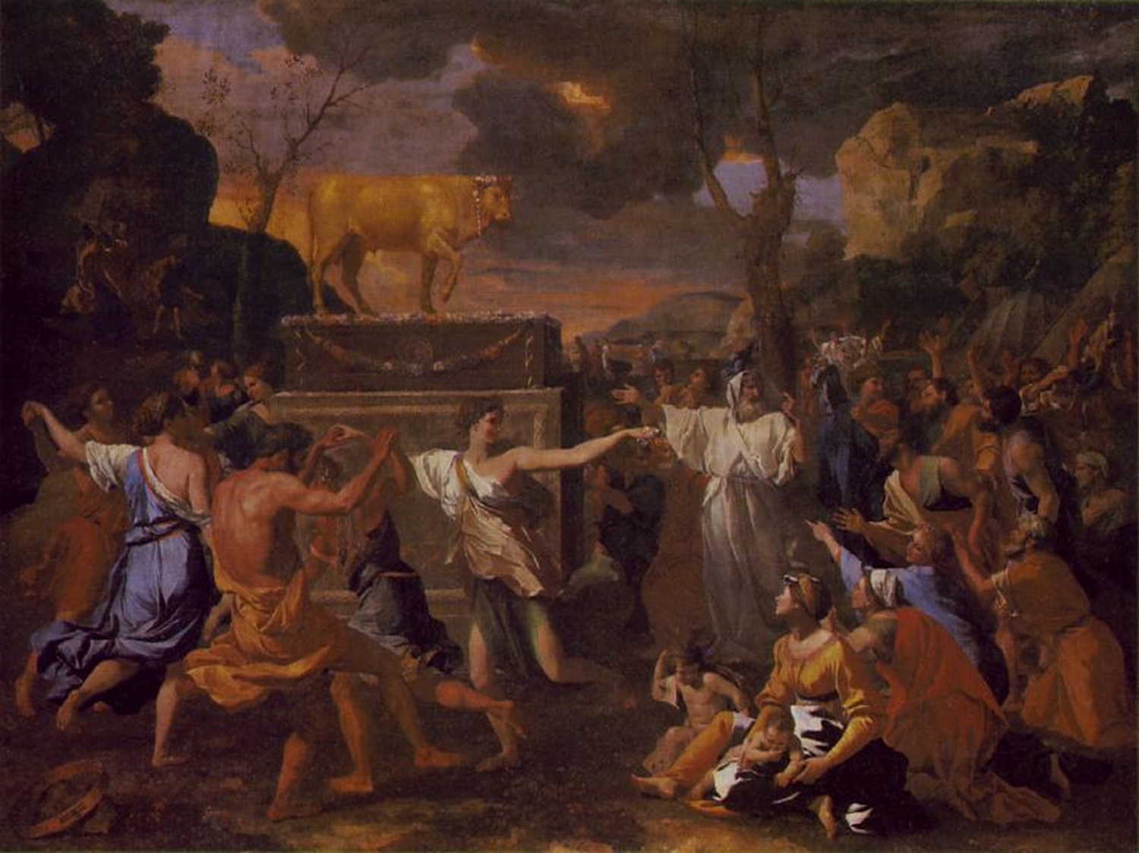
A Prayer of Remorse and Remembrance (5b-31)
God’s grace is shown in the Exodus (vs. 9-21)
16-18: He is patient with and faithful to them despite their sin and rebellion.

Slide 16
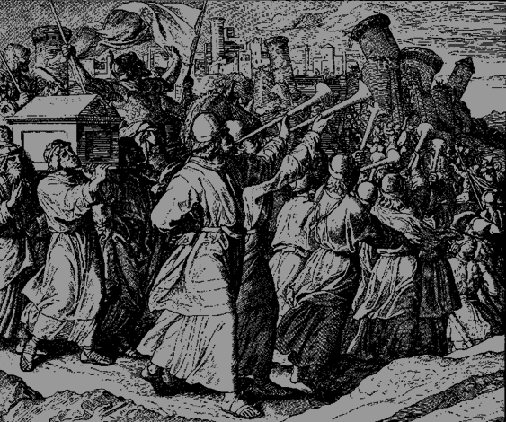
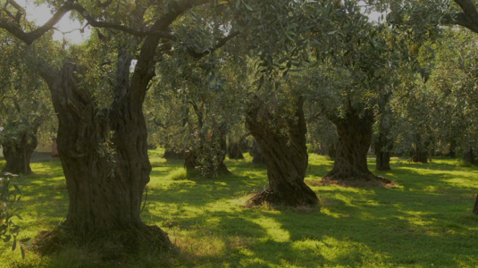
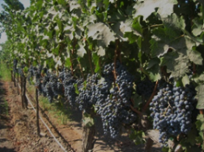
A Prayer of Remorse and Remembrance (5b-31)
God’s grace is shown in the Promised Land and exile (vs. 22-31)
22-25: He brought them victoriously into the Land and made them prosper.

Slide 17
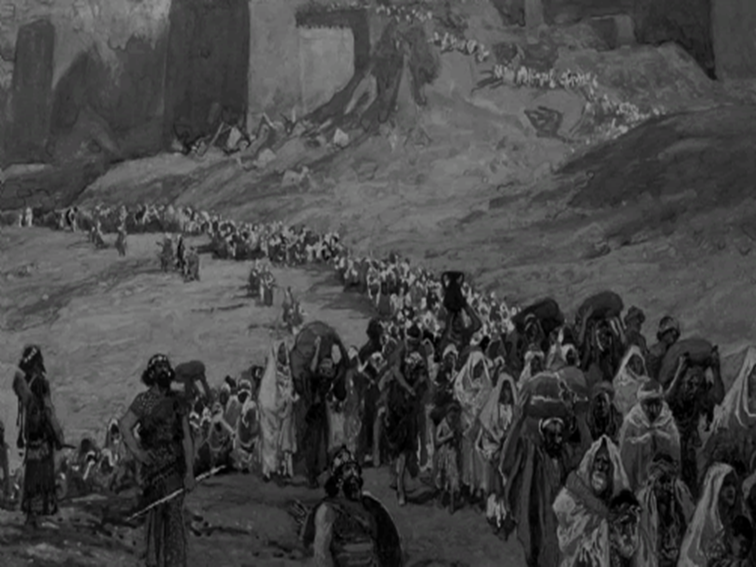
A Prayer of Remorse and Remembrance (5b-31)
God’s grace is shown in the Promised Land and exile (vs. 22-31)
26-31: They repeatedly rebelled against God, resulting in His increasingly serious discipline and ultimately ending in exile from the Land.

Slide 18
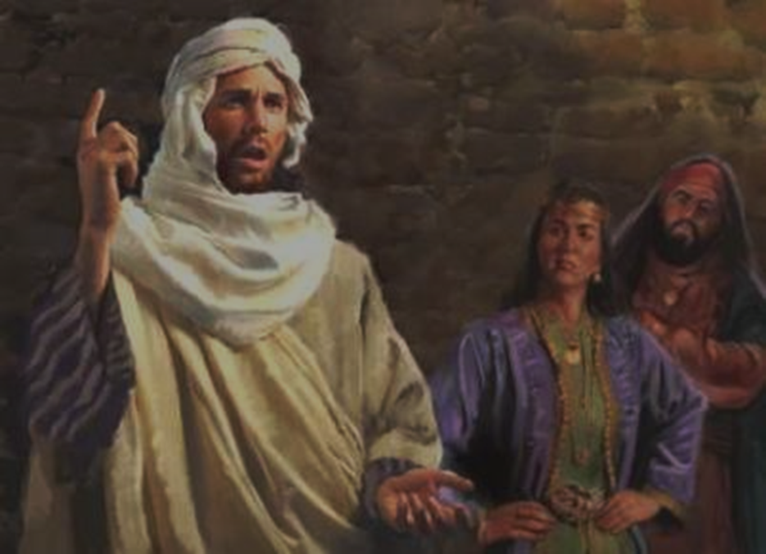
A Prayer of Remorse and Remembrance (5b-31)
God’s grace is shown in the Promised Land and exile (vs. 22-31)
27-28, 30: Nevertheless, God was repeatedly patient and merciful, giving many opportunities to repent and return to Him.

Slide 19
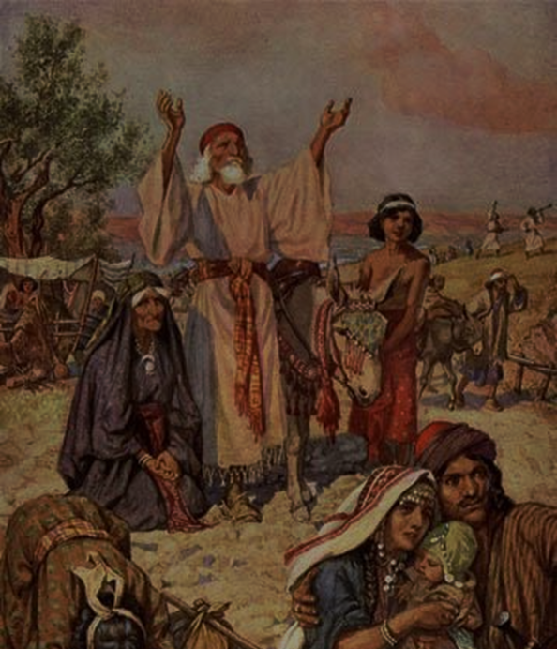
A Prayer of Remorse and Remembrance (5b-31)
God’s grace is shown in the Promised Land and exile (vs. 22-31)
31: Even after exile, in His grace and mercy, God did not forget His promises to Israel.

Slide 20
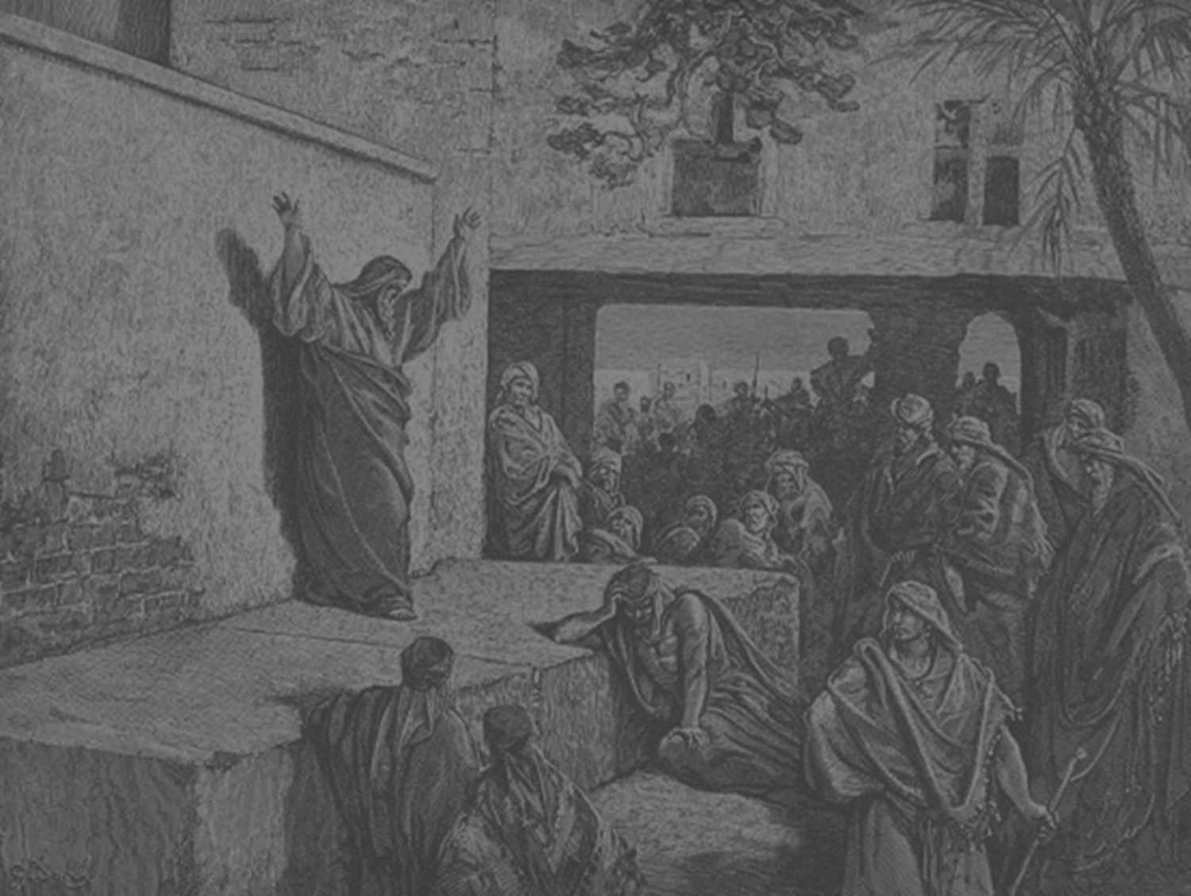
A Prayer of Praise and Petition (9:32-37)

Slide 21
The Prayer of Nehemiah 9:5b-37 Teaches Us:
What kind of God we serve—the sovereign Lord and Creator of all who is also a patient and gracious God
The key historical facts concerning the nation of Israel—its origin, identity, and place in God’s plan
The key reason why Israel ended up in exile outside the Promised Land: It was not a failure on God’s part, but because they repeatedly forsook and ignored Him

Slide 22
The Prayer of Nehemiah 9:5b-37 Teaches Us:
He loves us enough to warn and punish us when we go astray
The way to experience God’s grace and goodness after we have sinned is to repent, recognize our desperate need for Him to be our sovereign and gracious sustainer, protector, and deliverer and then obey Him

Slide 23
Main Idea:
God is faithful even when we are faithless, and His faithfulness should rouse us to repentance and a renewed resolve to worship and obey Him.

Slide 24
Personal Application:
What’s your own story and spiritual journey—the good, the bad, and the ugly?
How has God been writing His story into your own, demonstrating His sovereign grace and faithfulness to you?
How can you repentantly praise Him for it, and renew your commitment to let your story be increasingly His story?

Slide 25
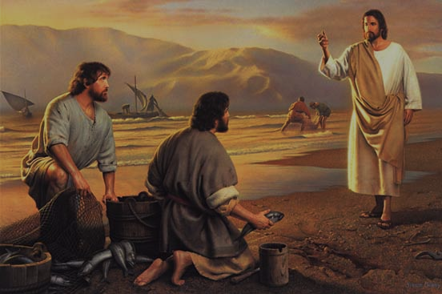
Peter’s Story

Slide 26
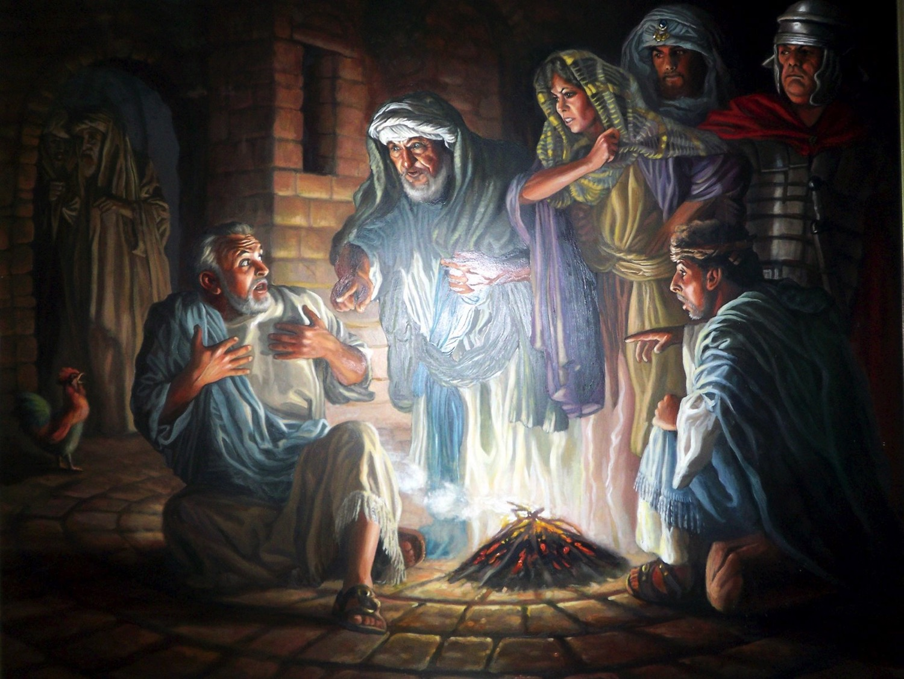
Peter’s Story

Slide 27
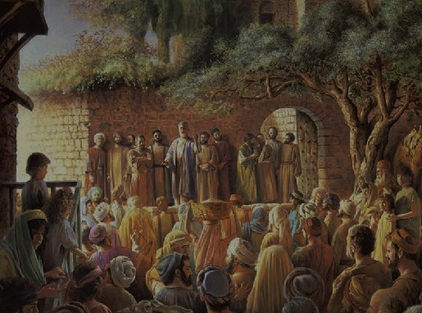
Peter’s Story

Slide 28
Black

Slide 29
OT Sermons link at BibleStudyDownloads.org
Get this presentation and script for free!

